Slide 1
Pediatrics and child health
OSCE2

Slide 2
Endocrinology

Slide 3
Hypothyroidism

Slide 4
CONGENITALHYPOTHYROIDISM
Most cases of congenital hypothyroidism are not hereditary and can occur sporadically and result from thyroid dysgenesis (anatomical).
Some cases may be familial, usually caused by one of the inborn errors of thyroid hormone synthesis, and may be associated with a goiter (Functional).
In many cases, the deficiency of thyroid hormone is severe, and symptoms develop in the early weeks of life.
The prevalence of congenital hypothyroidism based on nationwide programs(USA) for neonatal screening is 1/4,000 infants worldwide
Girls are more affected than boys(2X).

Slide 5
CONGENITAL HYPOTHYROIDISM
1.THYROID DYSGENESIS
2.DYSHORMONOGENESIS
3.Ingestion of goiterogenous substance by the mother during pregnancy
4.Iodine deficiency-
5.Hypothalamus and pituitary defect
6.TH unresponsiveness

Slide 6
Clinical Manifestation
Asymptomatic at birth even in case of agenesis
They have low serum T4 and elevated TSH and this will be detected during newborn screening.
F:M 2:1, birth wt and length normal but head size may be slightly increased
Prolonged physiologic jaundice, delayed passage of stool
Affected infants cry little, sleep much, have poor appetites, and are generally sluggish.
The abdomen is large, and an umbilical hernia is usually present.
The temperature is subnormal
Edema of the genitals and extremities may be present.

Slide 7
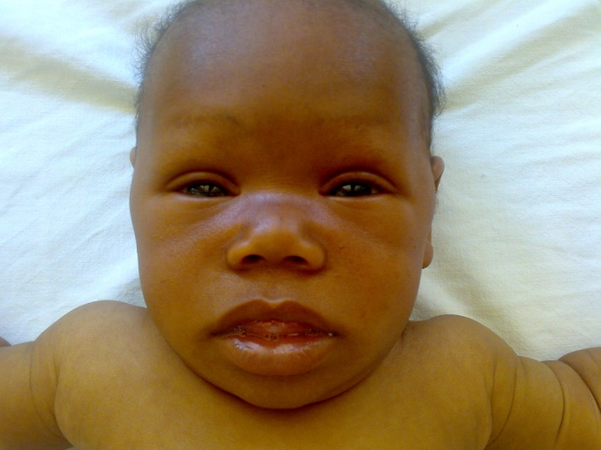
Clinical Manifestation

Slide 8
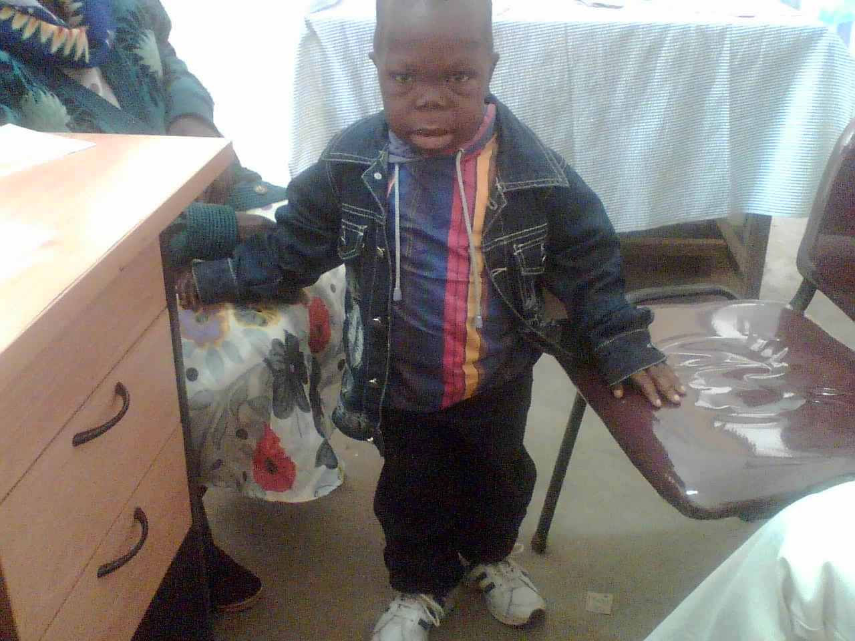
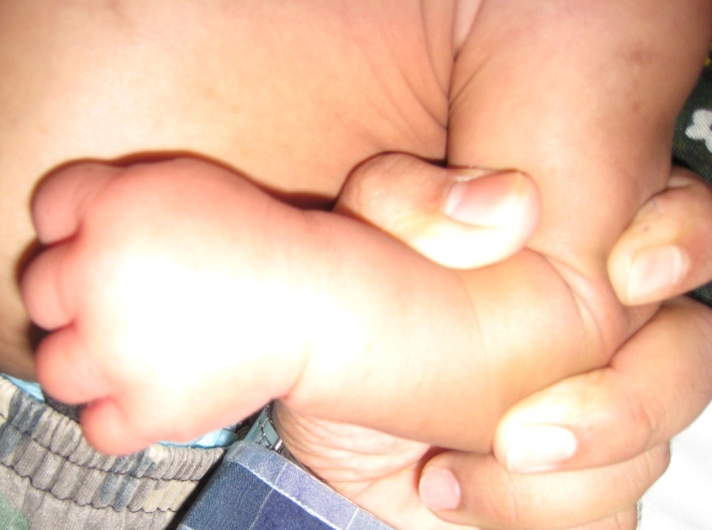

Slide 9
Investigation
Treatment
T3,T4 and TSH
Delayed bone age in around 60% of the cases.
Scintigraphy can help to pinpoint the underlying causes in infants with congenital hypothyroidism
ECG usually shows low voltage P and T waves with diminished QRS complex due to poor LV function and pericardial effusion.
L-thyroxine is the drug with a dose of 10 microgram/kg/day for neonates and 4 microgram/kg/day for children beyond neonatal age.
Prognosis
Early diagnosis and treatment from the first week of life will result in good prognosis.
Delay in diagnosis ,inadequate treatment and poor compliance will result in variable brain damage
Around 20 % of children will have a neuro sensorial hearing loss and without treatment affected infants become profoundly mentally deficit dwarfs.

Slide 10
Graves Disease
Graves disease occurs in 0.02% of children
peak incidence in the 11- to 15-yr of age
There is a 5 : 1 female to male ratio.
Most have a positive family history
Enlargement of the thymus, splenomegaly, lymphadenopathy, infiltration of the thyroid gland and retro-orbital tissues with lymphocytes and plasma cells, and peripheral lymphocytosis are well-established findings in Graves disease
Clinical manifestation
5% of all patients with hyperthyroidism are <15 yr of age
The peak incidence occurs during adolescence
Graves disease has begun between 6 wk and 2 yr of age in children born to mothers without a history of hyperthyroidism
The clinical course in children is highly variable but usually is not so fulminant as in many adults

Slide 11
MANIFESTATIONS OF HYPERTHYROIDISM
Symptoms
Hyperactivity, irritability, altered mood, insomnia, anxiety
Heat intolerance, increased sweating
Palpitations Fatigue, weakness ,Dyspnea
Weight loss with increased appetite, Pruritus , Increased stool frequency,
thirst and polyuria, Oligomenorrhea or amenorrhea
Signs
Sinus tachycardia, atrial fibrillation, supraventricular tachycardia
Fine tremor, hyperkinesis, hyperreflexia , Warm, moist skin
Palmar erythema, onycholysis ,Hair loss,
Osteoporosis
Muscle weakness and wasting, High-output heart failure
Chorea,Periodic (hypokalemic) paralysis ,Psychosis

Slide 12
MANIFESTATIONS OF GRAVES DISEASE
Diffuse goiter
Ophthalmopathy
A feeling of grittiness and discomfort in the eye,
Retrobulbar pain,Eyelid lag or retraction
Periorbital edema, chemosis, scleral injection
Exophthalmos ,Extraocular muscle dysfunction
Exposure keratitis,Optic neuropathy
Localized dermopathy (rare in children)
Lymphoid hyperplasia
Conditions associated with graves
Type 1 diabetes mellitus
Addison disease
Vitiligo
Pernicious anemia
Alopecia areata
Myasthenia gravis
Celiac disease

Slide 13
Thyroid crisis or thyroid storm
is a form of hyperthyroidism manifested by an acute onset, hyperthermia, severe tachycardia, heart failure, and restlessness
May be rapid progression to delirium, coma, and death
Precipitating events include trauma, infection, radioactive iodine , or surgery
These symptom complexes are rare in children
Laboratory findings
T₄ and T₃ are elevated
Levels of TSH are suppressed
Antithyroid antibodies are often present
Radioiodine is rapidly and diffusely concentrated in the thyroid
Bone density may be reduced at diagnosis but returns to normal with treatment

Slide 14
Treatment
Initial medical therapy using antithyroid drugs rather than radioiodine or subtotal thyroidectomy
Radioiodine is gaining acceptance as initial treatment in children >10 yr of age
All therapeutic options have advantages and disadvantages
The 2 antithyroid drugs used historically are propylthiouracil (PTU) and methimazole
Both compounds inhibit incorporation of trapped inorganic iodide into organic compounds, and they might also suppress TRSAb levels by directly affecting intrathyroidal autoimmunity

Slide 15
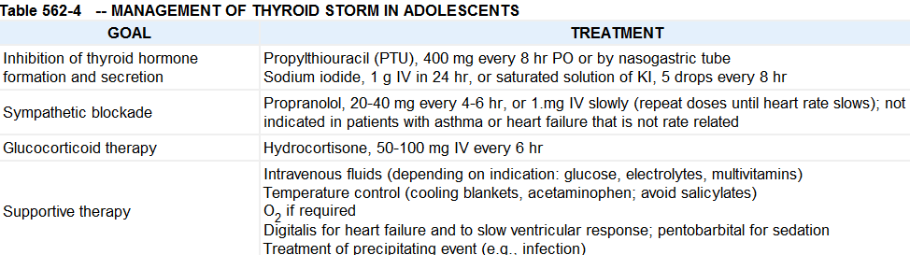

Slide 16
Congenital Hyperthyroidism
Neonatal Graves disease is caused by transplacental passage of TRSAb
If the infant has been exposed to antithyroid drugs, onset of symptoms is delayed by 3-4 days
If TRBAb is also present, onset of hyperthyroid symptoms may be delayed for several weeks
Neonatal hyperthyroidism occurs in only 2% of infants born to mothers with Graves disease
Male and female affects equally
The disorder usually remits spontaneously within 6-12 wk but can persist longer, depending on the levels of TRSAb
Mild asymptomatic hyperthyroxinemia also occurs
Have family histories of Graves disease

Slide 17
Clinical Manifestations
Most are premature and, have IUGR and goiters
The infant is extremely restless, irritable, and hyperactive and appears anxious and unusually alert
Microcephaly and ventricular enlargement
Eyes are opened widely and exophthalmic
Extreme tachycardia and tachypnea, and elevated To.
In severely affected infants, there is a progression of symptoms; weight loss occurs despite a ravenous appetite, hepatosplenomegaly , and jaundice
Severe hypertension and cardiac filure
Can die if therapy is not instituted promptly
T₄ and T₃ are markedly elevated, and TSH is suppressed
Advanced bone age, frontal bossing with triangular facies, and cranial synostosis are common, especially in infants with persistent clinical manifestations of hyperthyroidism

Slide 18
Treatment
Oral administration of propranolol (1-2 mg/kg/24 hr, orally in 3 divided doses) and methimazole (0.25-1.0 mg/kg/24 hr given every 12 hr); Lugol solution (1 drop every 8 hr) may be added.
If the thyrotoxic state is severe, parenteral fluid therapy and corticosteroids
After a euthyroid state is reached, only antithyroid drug treatment is necessary
The dose should be gradually tapered to keep the infant euthyroid
Most cases remit by 3-4 mo of age
Prognosis
Advanced osseous maturation, microcephaly, and mental retardation occur with delayed treatment
Intellectual development is normal in most treated infants
In utero hyperthyroidism appears to suppress the hypothalamic-pituitary-thyroid feedback mechanism, and develop permanent central hypothyroidism, requiring lifelong thyroid hormone treatment

Slide 20
DKA management

Slide 21
General Resuscitation Measure
Acute management should follow the general guidelines for PALS
A→If comatose insert NGT and maintain the airway
B→Give oxygen by face mask for patients with severe circulatory impairment or shock
C→Insert IV cannula and take blood sample and if the child is in shock give 20 ml/kg of 0.9 % normal saline to the maximum of 30 ml/kg depending on the response of the child over 30 minutes
Expand intravascular volume
Rehydration therapy
Potassium replacement therapy
Insulin therapy
Avoid complications ( Hypoglycemia, Cerebral edema and Hypokalemia )
Treat precipitating factors
Follow up

Slide 22
Fluid therapy
Expand intravascular volume
Bolus fluid 10 - 20 ml /kg 0.9 % N/S to be given over 1-2 hours can be repeated if necessary
should be gradual and with isotonic fluids or ringers lactate.
repeat the same volume if circulating volume is still compromised.
Maintenance fluid /48 hours + Deficit fluid - Bolus fluid = --------ml/ 48 hr with potassium 40 mmol in 1000 ml of normal saline.
  Deficit=85ml/kg

Slide 23
Potassium
K + Replacement therapy is required regardless of the serum potassium concentration.
40 mmol in 1000 ml of normal saline.
Make sure that the child is passing urine before initiation of KCL.
Can be given as potassium phosphate or acetate or chloride with a rate of 0.5 mmol/kg/hr (20-80 mmol/l of fluid)
Administration of potassium entirely as potassium chloride contributes to the risk of hyperchloremic metabolic acidosis, whereas administration entirely as potassium phosphate can result in hypocalcemia
Keep mannitol at the bed side (dose 0.5-1 gm/kg IV over 20 min

Slide 24
INSULIN
Start insulin infusion 1-2 hours after starting fluid management (Intravascular volume expansion)
Regular insulin 0.1 u/kg/hour.
Low dose iv insulin administration should be the standard of care
If continuous IV administration of insulin is not possible regular insulin SC or IM with a dose: 0.1 unit/kg every 1-2 hours can be given.
If this is not practical
  give 0.5 u/kg every 6 hourly (½ IM and ½ sc for the first dose )
  continue with 0.5 u/kg sc every 4-6 hours.
Notes:
(e.g. dilute 50 units Regular [soluble] insulin in 50 ml N/S 1 unit = 1 ml) IV infusion

Slide 25
cont...
Don’t omit insulin is the key
If there is a rapid decline of glucose > 90 mg/dl /hour
  decrease the dose to 0.05 u/kg/hr and
  Change the fluid to ½ N/S in 10 % D/W.
  Consider adding glucose even before plasma glucose has decreased to 250 mg - 300 mg/dl.
Continue the management until the child is out of DKA ( PH > 7.3 or bicarbonate >15 mmol/l )
To prevent rebound hyperglycaemia the first SC injection should be given 1-2 hours (with Regular insulin) before stopping the insulin infusion.

Slide 26
cont...
Bicarbonate: Indicated if there is only severe acidosis PH < 6.9
Oral fluids- can be introduced when there is marked clinical improvement (mild acidosis or ketosis can be there)
Treat the infection
Infection
Stress
Insulin omission

Slide 27
Complications of management
Hypoglycemia
Hypokalemia
Cerebral edema

Slide 28
Management complications
Hypoglycemia
Hypoglycemic Reactions (Insulin Shock): symptoms and signs include pallor, sweating, apprehension, trembling, tachycardia, hunger, drowsiness, mental confusion, seizures and coma.
Insulin decrease the dose to 0.05 u/kg/hr and you can change the fluid to ½ N/S in 10 % D/W. Consider adding glucose even before plasma glucose has decreased to 250 mg - 300 mg/dl.
glucagon 0.5 mg is administered to an unconscious or vomiting child

Slide 29
Cerebral edema
Major life-threatening complication seen in the treatment of children with DKA
Usually develops several hours after the institution of therapy
Most commonly presents in
  Children between 5 –14 years
  With new onset diabetes
  Longer duration of symptoms
  Greater hypocapnia at presentation after adjusting for degree of acidosis
  Increased serum urea nitrogen at presentation
  More severe acidosis
  Bicarbonate treatment for correction of acidosis

Slide 30
Cerebral edema
Signs and symptoms of cerebral edema include:
  Headache and slowing of heart rate
  Change in neurological status (restlessness, irritability, increased drowsiness,and incontinence)
  Specific neurological signs (e.g., cranial nerve palsies, papilledema)
  Rising blood pressure
  Decreased O2 saturation
Diagnosis
Abnormal motor or verbal response to pain
Decorticate or decerebrate posture
Cranial nerve palsy (especially III, IV, and VI)
Abnormal neurogenic respiratory pattern

Slide 31
Cont.
  Major criteria
    Altered mentation/fluctuating level of consciousness
    Sustained heart rate deceleration (decrease >20 beats/min) not attributable to improved intravascular volume or sleep state
    Age-inappropriate incontinence
Minor criteria
  Vomiting
  Headache
  Lethargy or not easily arousable
  Diastolic blood pressure >90mmHg
  Age <5 yr
  One diagnostic, 2 major or one major and 2 minor criteria for diagnosis
  92% sensitivity and 96% specificity

Slide 32
Treatment of CE
Give mannitol 0.5-1 gram/kg IV over 20 minutes and repeat if there is no initial response in 30 minutes to 2hrs
Reduce the rate of fluid administration by one third
Hypertonic saline (3%), 5-10 mL/kg over 30 minutes, may be an alternative to mannitol, especially if there is no initial response to 1mg/kg mannitol.
Mannitol should be available at Bedside
Intubation may be necessary for the patient with impending respiratory failure, and hyperventilation (to a pCO2 <22 mm Hg [2.9 kPa])
Elevate the head of the bed to 30◦
After treatment has been started, a CT scan should be obtained to rule out other possible intracerebral causes of neurologic deterioration

Slide 33
Monitoring
Prevention
Advise on adherence and appropriate storage of insulin( insulin omission commonest cause)
Advise on what to do when they have poly symptom and other symptoms of DKA( stressful conditions and signs of an impending DKA)
Advise on self monitoring of blood sugar
We follow DKA patients with a DKA flow sheet which has the following components:
  Date and Time
  Vitals and RBS
  Urine glucose
  Urine ketone every 2 hour
  Electrolyte(K + every (2-4 hrs)
  Neurologic status (GCS) hourly
  Insulin dose
  Fluid input/output

Slide 34
Adrenocortical Insufficiency
In primary adrenal insufficiency it prevents production of cortisol and often aldosterone.
Dysfunction of the hypothalamus or anterior pituitary gland may cause a deficiency of corticotropin (ACTH) and lead to hypofunction of the adrenal cortex; this is termed secondary adrenal insufficiency .
Etiologies
1.Congenital Adrenal Hyperplasia (Inborn defects of steroidogenesis).
2.Adrenal hypoplasia congenita
3.Adrenoleukodystrophy
4.Familial Glucocorticoid deficency
5.Disorder of cholesterol synthesis

Slide 35
1.Congenital Adrenal Hyperplasia
75 % of Infants with 21-hydroxylase deficiency,
Almost all infants with lipoid adrenal hyperplasia, and
Most infants with a deficiency of 3β-hydroxysteroid dehydrogenase
Newborns with the above conditions will manifest with salt-losing symptoms because they are unable to synthesize either cortisol or aldosterone.
Depending on the enzymatic step that is deficient, there may be signs, symptoms, and laboratory findings of
Incomplete virilization or premature puberty in affected males and
Virilization or sexual infantilism in affected females.
Mineralocorticoid deficiency or excess;

Slide 36
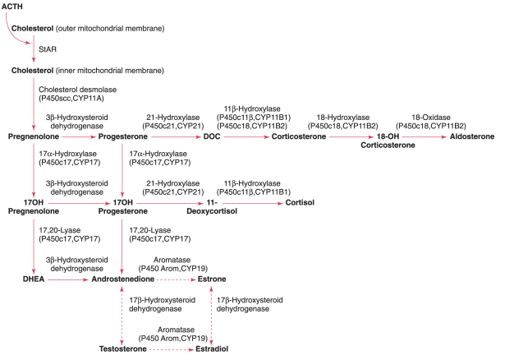
Steroidogenesis

Slide 37
Congenital Adrenal Hyperplasia
21 alpha hydroxylase deficiency is the commonest one and followed by 11 beta hydroxylase deficiency and 3B- dehydoxylase enzyme deficiency

Slide 38
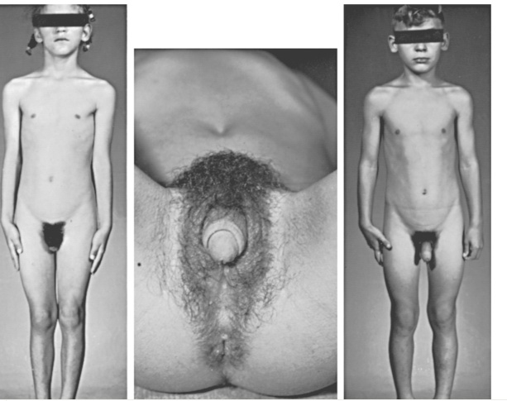
Congenital Adrenal Hyperplasia

Slide 39
Laboratory findings
Low Na + and K+ is high,
cortisol level is decreased and
ACTH is increased in case of primary adrenal insufficiency.
The most definitive test for adrenal insufficiency is measurement of serum levels of cortisol before and after administration of ACTH.

Slide 40
Treatment
Treatment of acute primary adrenal insufficiency must be immediate and vigorous.
Give 5 % D/W with 0.9 % N/S to correct hypoglycemia, hyponatremia and hypotension.
If the hyperkalemia is sever it needs treatment. IV hydrocortisone should be given.
After the acute manifestation is under control most patients require chronic replacement therapy for their cortisol and aldosterone deficiencies with a dose of 6-12 mg/m²/day hydrocortisone and 0.1 mg fludrocortisone replacement therapy.

Slide 41
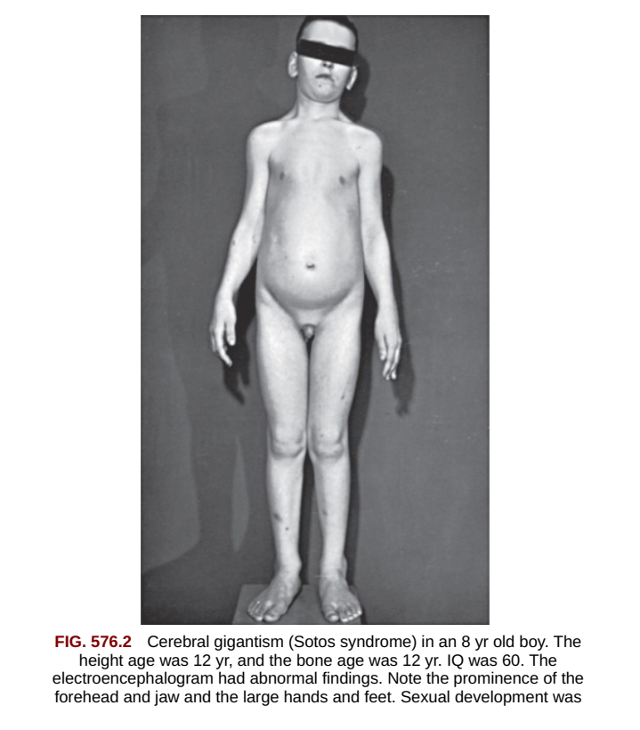
Growth hormone

